Slide 1

Lecture 7
Organic Chemistry: Fundamentals and Applications (CSO201A)
Dr. Srinivas Dharavath
Assistant Professor
Department of Chemistry
Indian Institute of Technology, Kanpur
Kanpur- 208016
E-mail: srinivasd@iitk.ac.in

Slide 2
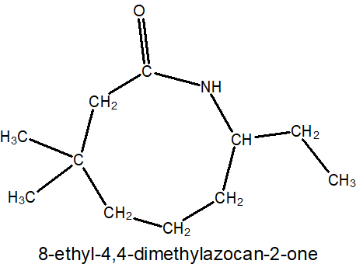
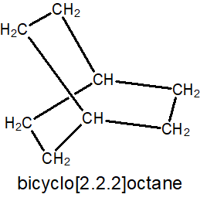
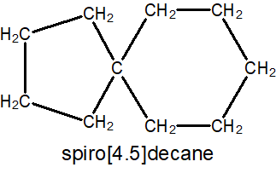

You will be able to name any cyclic organic molecule as per IUPAC rules

Slide 3
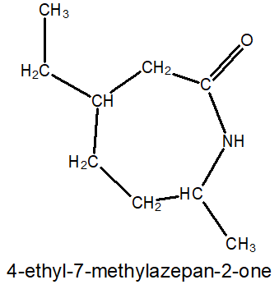
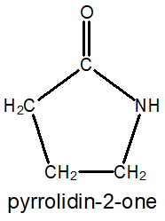
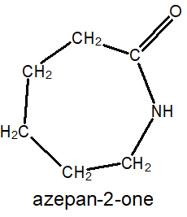
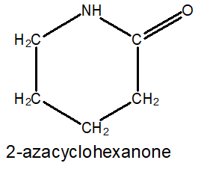
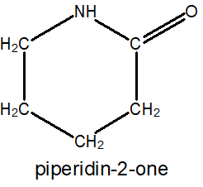
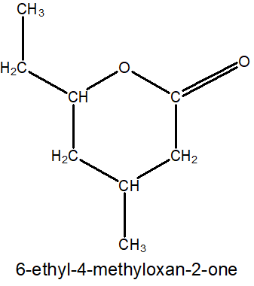
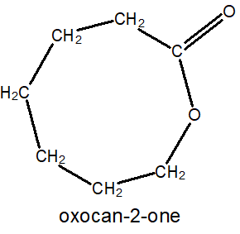
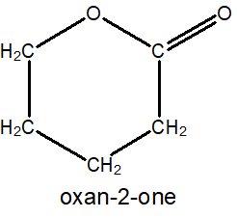
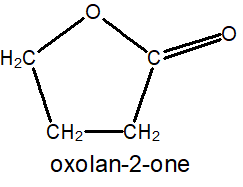
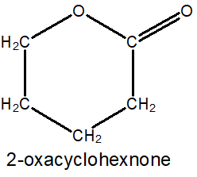

Alicyclic Compounds Contd.
Alicyclic Compounds Containing Functional Groups: (Lactums) 1. Cyclic amides (lactum): 2-azacycloalkanone
3
2
2
1
4
2
1
2
1
1
5
6
7
Preferred IUPAC Name (PIN)
Preferred IUPAC Name (PIN)
Preferred IUPAC Name (PIN)
Preferred IUPAC Name (PIN)
Alicyclic Compounds Containing Functional Groups: (Lactones) 2. Cyclic esters (lactone): 2-oxacycloalkanone
1
1
1
2
2
6
2
2
1
3
5
4
Preferred IUPAC Name (PIN)
Preferred IUPAC Name (PIN)
Preferred IUPAC Name (PIN)
Preferred IUPAC Name (PIN)

Slide 4
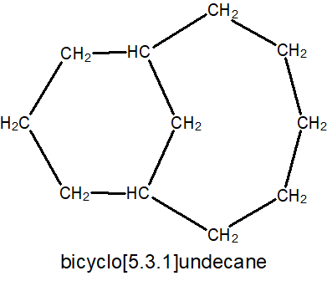
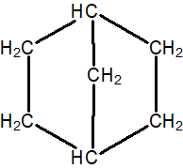
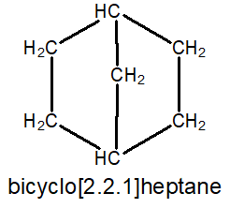
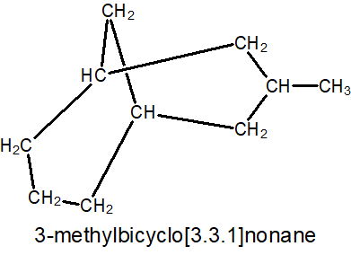
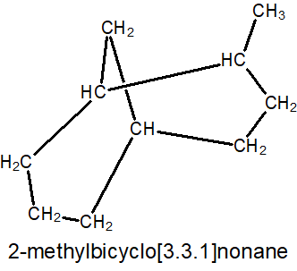
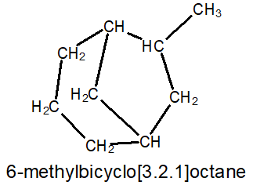

7. Bicyclo Alkanes
Bicyclo alkanes:
1. Write prefix Bicyclo before alkane and the number of bridge carbons in brackets between the two.
2. Write the numbers in descending order within brackets→ “Bicyclo [x.y.z] alkane”. Where, x>y>z.
3. If substituents present:
1st bridge head →longest bridge →medium-sized bridge →smallest bridge.
Bridge head carbon
Bridge
Bridge
Bridge head carbon
9
Bridge
5
2
4
6
1
7
8
3
8
5
4
3
7
2
1
6

Slide 5
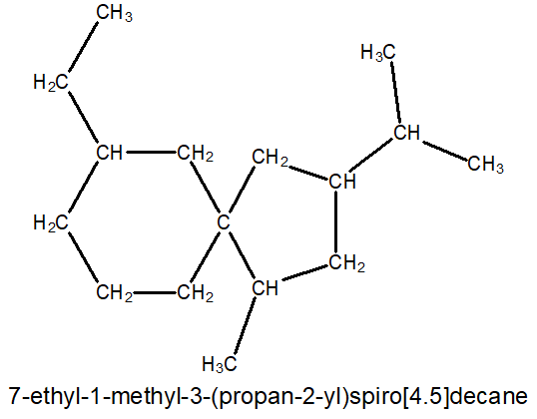
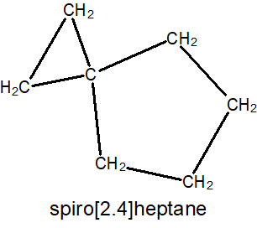
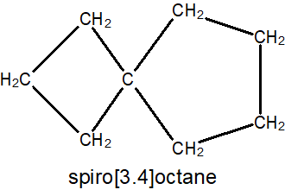
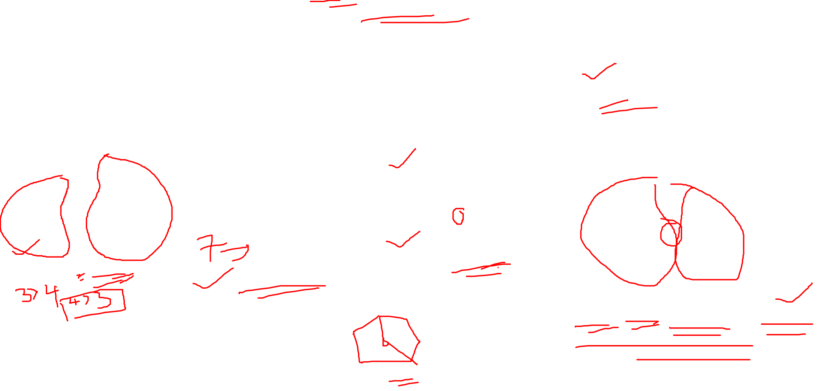
8. Spiro Compounds
Spiro Compounds:
1. Use prefix Spiro before alkane and number of carbons of two rings in between.
2. Write the number of carbons of two rings in ascending order within brackets.
3. If substituents: smaller ring’s carbon adjacent to quaternary spiro carbon gets 1st.
7
6
4
3
8
5
2
9
10
1

Slide 6
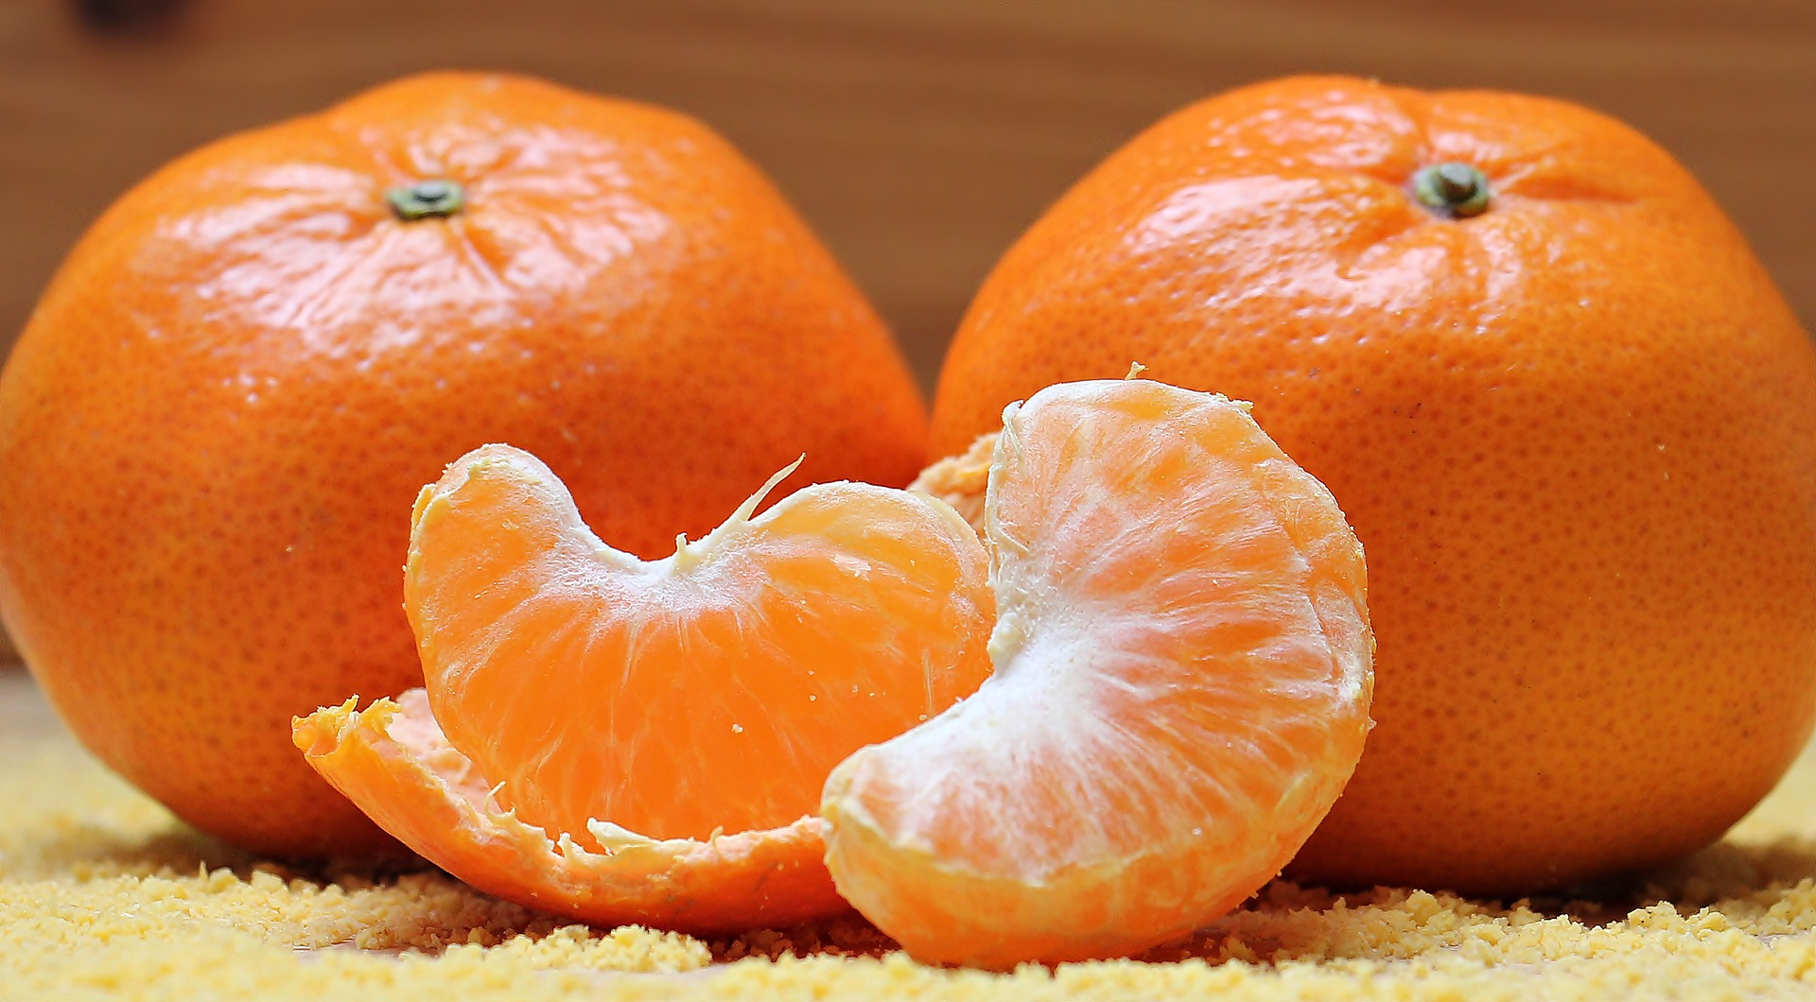
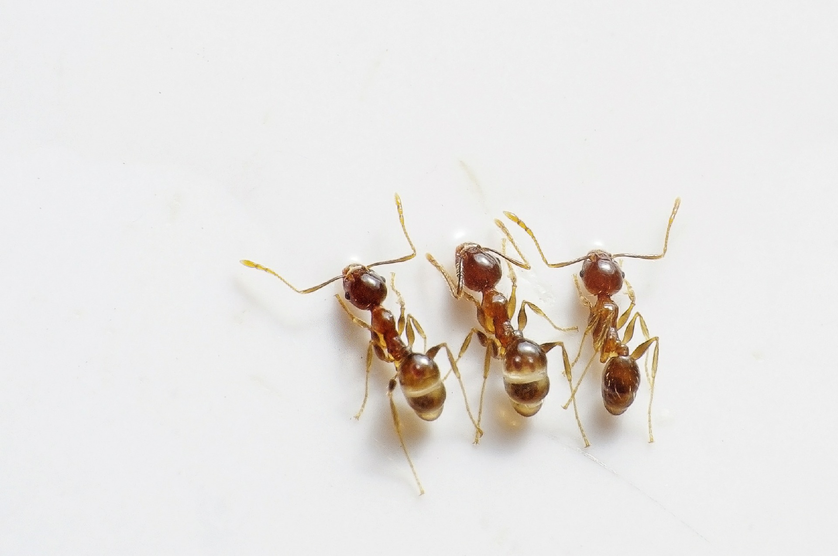
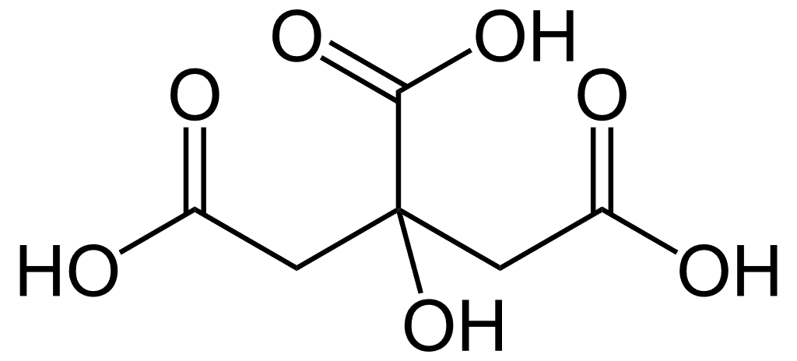
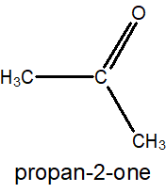
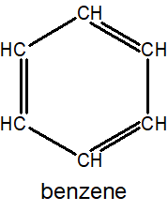
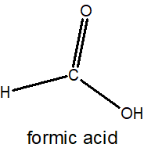
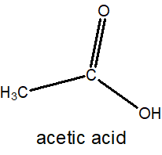

9. Trivial Naming
Common/Trivial naming: (Before IUPAC Naming)
1. Naming based on their origin/source or specific property.
1. Citric acid→ citrus fruits
2. Formic acid→ formica (ant in latin)
3. CHCl₃ → chloroform (chlorination of drinking water & swimming pools)
4. CH₃-CO-CH₃ → acetone
5. CH₃-COOH → acetic acid
6. C₆H₆ → benzene (gum benzoin, aromatic resin)
7. CH₄ → methane
Citric acid

Slide 7

IUPAC Advanced-2 Course: Review
Alicyclic Compounds Containing Functional Groups: (Lactums)
1. Cyclic amides (lactum): 2-azacycloalkanone
Alicyclic Compounds Containing Functional Groups: (Lactones)
2. Cyclic esters (lactone): 2-oxacycloalkanone
Bicyclo alkanes:
1. Write prefix Bicyclo before alkane and the number of bridge carbons in brackets between the two.
2. Write the numbers in descending order within brackets→ “Bicyclo [x.y.z] alkane”. Where, x>y>z.
3. If substituents present:
1st bridge head →longest bridge →medium-sized bridge →smallest bridge.
Spiro Compounds:
1. Use prefix Spiro before alkane and number of carbons of two rings in between.
2. Write the number of carbons of two rings in ascending order within brackets.
3. If substituents: smaller ring’s carbon adjacent to quaternary spiro carbon gets 1st.
Common/Trivial naming: (Before IUPAC Naming)
1. Naming based on their origin/source or specific property.

Slide 8
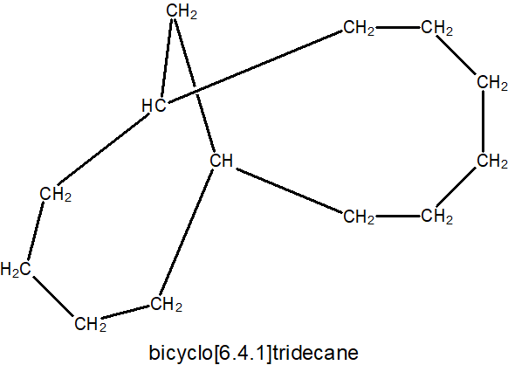
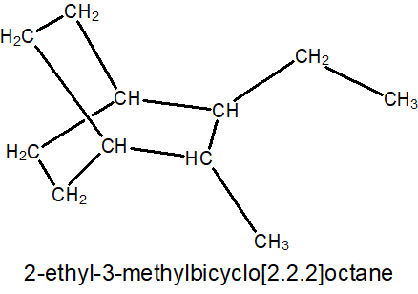
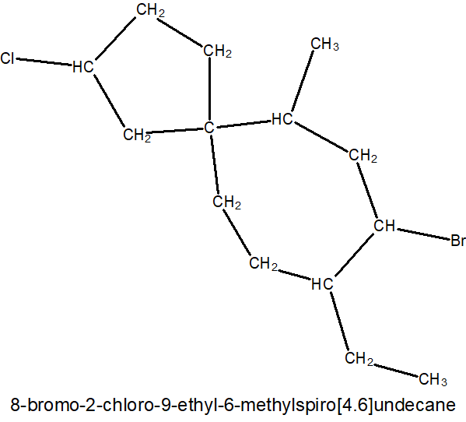
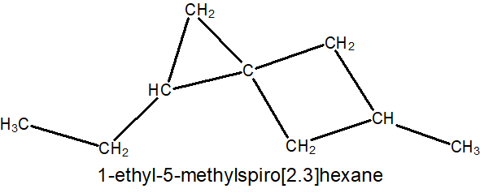
PRACTICE
2
3
1
5
4

Slide 9
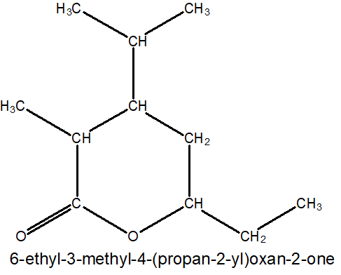
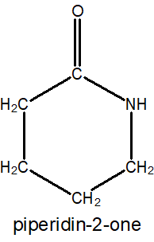
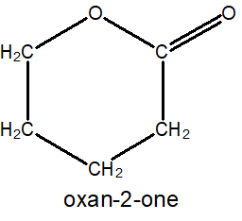
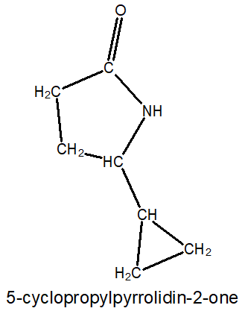
PRACTICE
6
7
8
9
10

